Slide 1
A Brief Introduction to Reinforcement Learning
Mantian

Slide 2
Outline
Reinforcement learning: a brief introduction
Deep Q-Network & Implementation
Further Advances

Slide 3

History of Reinforcement Learning
The idea that we learn by interacting with our environment is probably the first to occur to us when we think about the nature of learning….
Reinforcement learning problems involve learning
what to do - how to map situations to actions - so as to maximize a numerical reward signal.
Notes:
Reinforcement learning, like many topics whose names end with \ing," such as machine
learning and mountaineering, is simultaneously a problem, a class of solution
methods that work well on the class of problems, and the eld that studies these problems
and their solution methods.

Slide 4


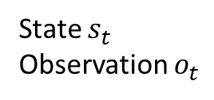
Reinforcement Learning
Environment
a set of environment states S;
a set of actions A;
rules of transitioning between states;
rules that determine the scalar immediate reward of a transition; and
rules that describe what the agent observes.
Action $a_{t−1}$
Reward $r_{t}$
State $s_{t}$
Observation $o_{t}$
Agent
Goal: Maximize expected long-term payoff

Slide 5
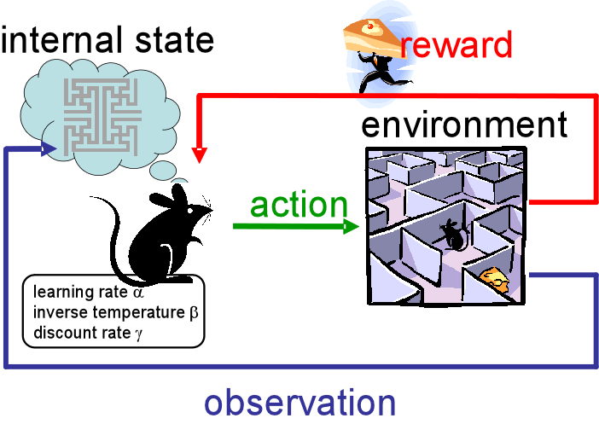
RL vs Machine Learning
Supervised learning
Regression, classification, ranking,
Learning from examples, learning from a teacher
Unsupervised learning
Dimension reduction, density estimation, clustering
Learning without supervision
Reinforcement learning
Sequential decision making
Learning from interaction, learning by doing, learning from delayed reward

Slide 6
Examples
 | State | Action | Reward
Go | Position | Move | Terminal Reward (Win/Loss)
Video Game | Snapshots/True state | Keyboard/Mouse | Defined by the game
Can-Recycling Robot | Sensors outputs, battery | Search/Wait/Go Recharging | Defined by the goal
Aircraft | Position, velocity,… | torque | Defined by the goal
….

Slide 7
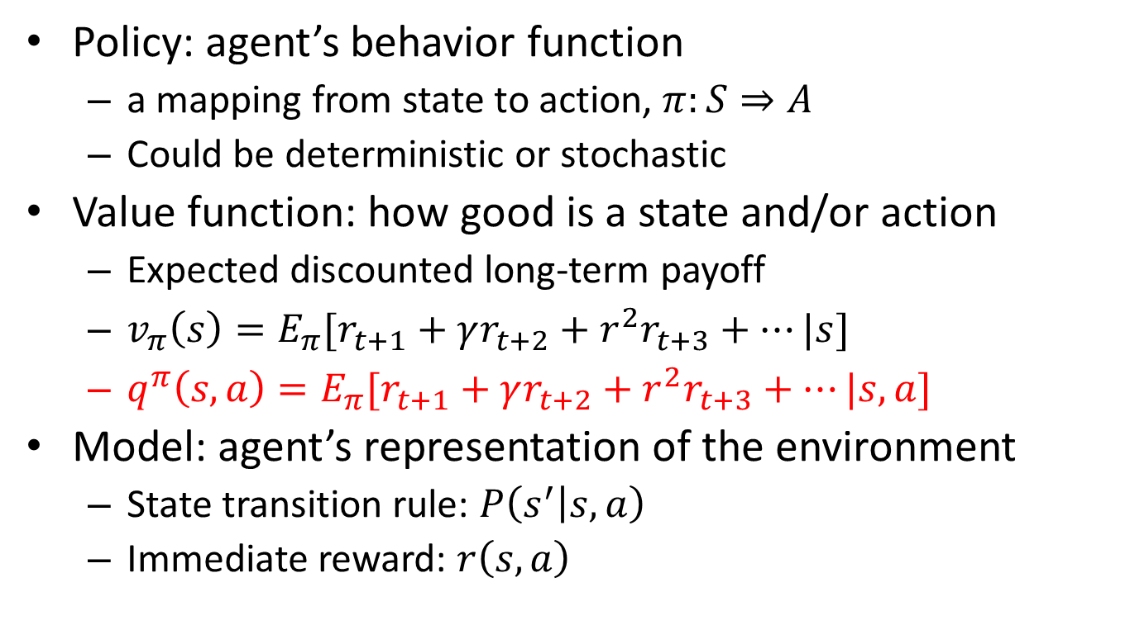
Major components of a RL agent
Policy: agent’s behavior function
a mapping from state to action, $π:S⇒A$
Could be deterministic or stochastic
Value function: how good is a state and/or action
Expected discounted long-term payoff
$v_{π}\left(s\right)=E_{π}[r_{t+1}+γr_{t+2}+r^{2}r_{t+3}+…|s]$
$q^{π}\left(s,a\right)=E_{π}[r_{t+1}+γr_{t+2}+r^{2}r_{t+3}+…|s,a]$
Model: agent’s representation of the environment
State transition rule: $P\left(s^{′} | s,a\right)$
Immediate reward: $r\left(s,a\right)$
Action-value
function

Slide 8
Three challenges
Delayed reward
An action determines not only its immediate reward, but also influence (maybe probabilistically) the long-term rewards
Exploitation-Exploration (EE) tradeoff
Generalization

Slide 9
Markov Decision Processes
Markov decision processes formally describe an environment for reinforcement learning
Where the environment is fully observable
i.e. The current state completely characterizes the process
POMDP(Partially observable MDP)
Almost all RL problems can be formalized as MDPs
States are representations of history
Agent takes actions based on states instead of the history

Slide 10
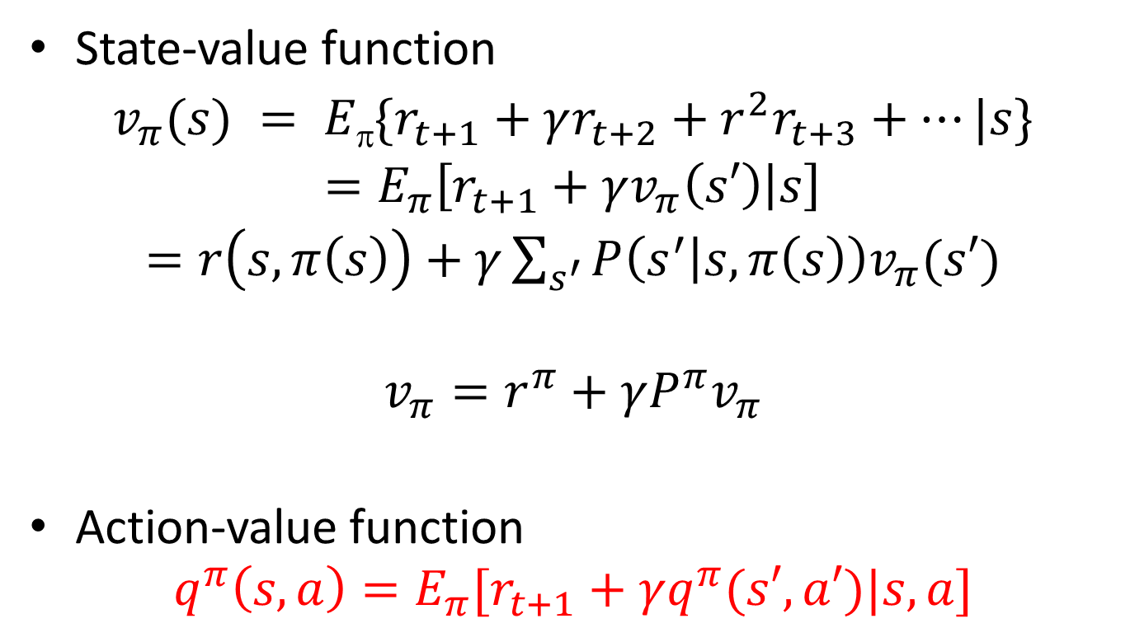
Bellman expectation equation
State-value function
$v_{π}(s) = E\{r_{t+1}+γr_{t+2}+r^{2}r_{t+3}+…|s\}$
$=E_{π}\left[r_{t+1}+γv_{π}\left(s′\right) | s\right]$
$=r\left(s,π\left(s\right)\right)+γ\sum_{s^{′}}{P\left(s^{′} | s,π\left(s\right)\right)v_{π}(s′)}$
$$v_{π}=r^{π}+γP^{π}v_{π}$$
Action-value function
$$q^{π}\left(s,a\right)=E_{π}[r_{t+1}+γq^{π}(s′,a′)|s, a]$$

Slide 11
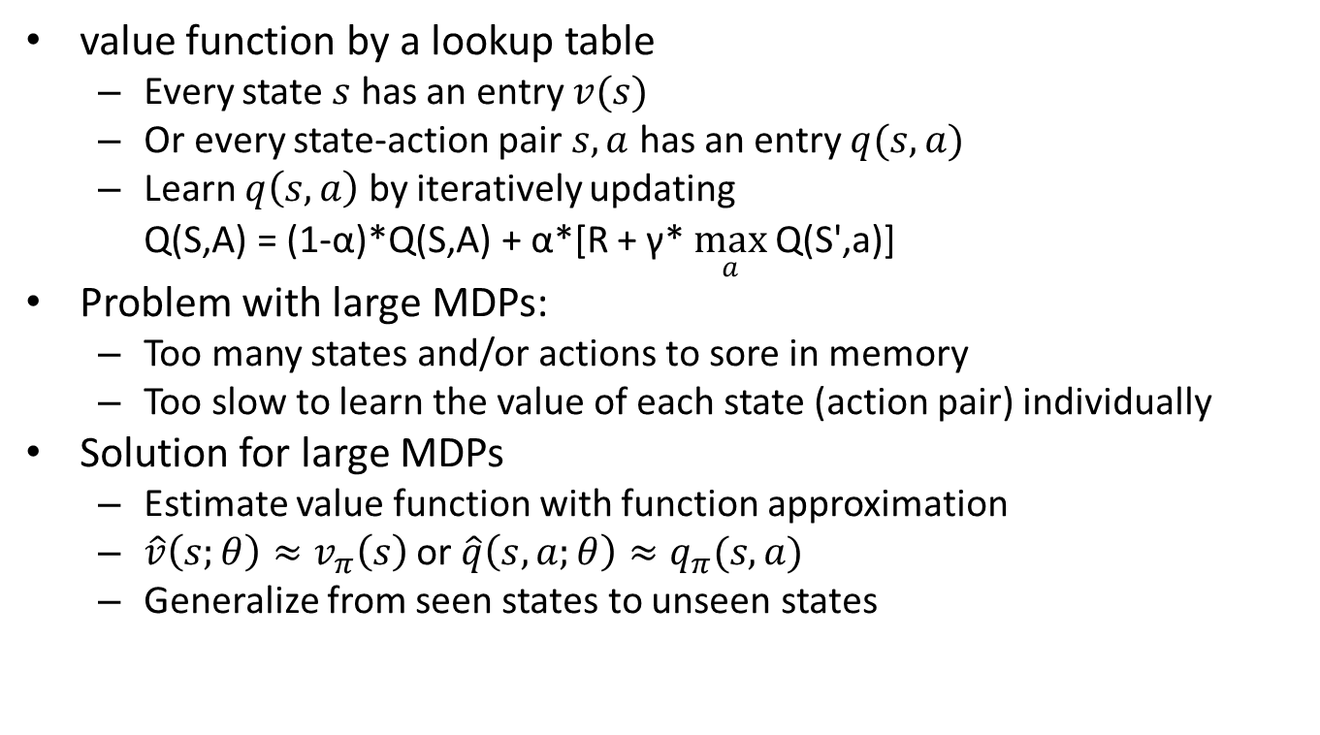
Approximation Algorithms for RL
value function by a lookup table
Every state $s$ has an entry $v(s)$
Or every state-action pair $s,a$ has an entry $q(s,a)$
Learn $q\left(s,a\right)$ by iteratively updating
Q(S,A) = (1-α)*Q(S,A) + α*[R + γ* $\max_{a}$Q(S',a)]
Problem with large MDPs:
Too many states and/or actions to sore in memory
Too slow to learn the value of each state (action pair) individually
Solution for large MDPs
Estimate value function with function approximation
$\hat{v}\left(s;θ\right)≈v_{π}\left(s\right)$ or $\hat{q}\left(s,a;θ\right)≈q_{π}(s,a)$
Generalize from seen states to unseen states

Slide 12
Deep Q-Networks
DQN provides a stable solution to deep value-based RL
DNN as function approximators to estimate Q(s,a)
Trained off-policy with experience replay buffer
Break correlations in data, bring us back to iid setting
Learn from all past policies
Using off-policy Q-learning
Freeze target Q-network
Avoid oscillations
Break correlations between Q-network and target

Slide 13

Representations of Atari Games
End-to-end learning of values $Q(s, a)$from pixels
Input state $s$ is stack of raw pixels from last 4 frames
Output is $Q(s,a)$ for 18 joystick/button positions
Reward is change in score for that step

Slide 14

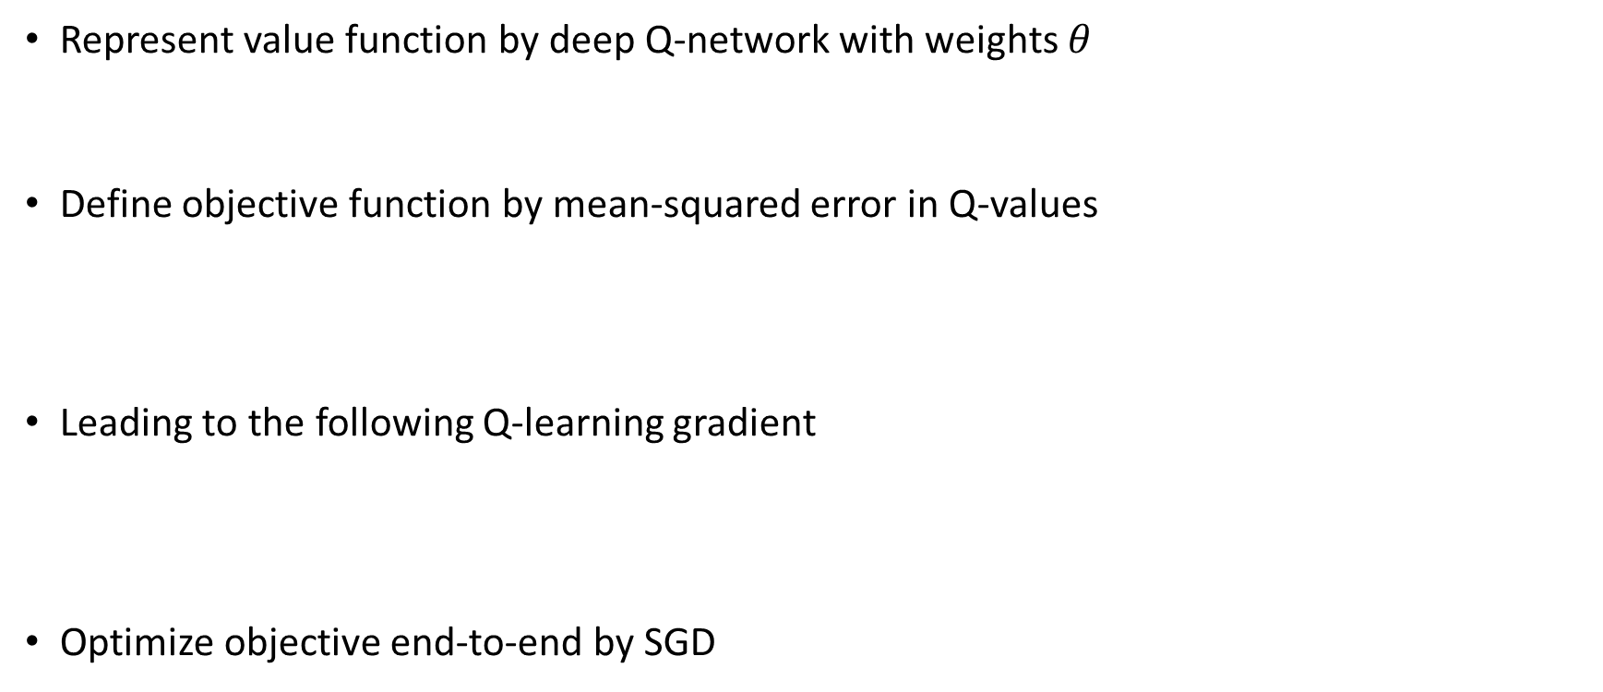
Value Iteration with Q-Learning
Represent value function by deep Q-network with weights $θ$
Define objective function by mean-squared error in Q-values
Leading to the following Q-learning gradient
Optimize objective end-to-end by SGD
$$Q\left(s,a;θ\right)≈Q^{π}(s,a)$$
$$L\left(θ\right)=E\left[{\left(r+γ\max_{a^{′}}Q\left(s^{′},a^{′};θ\right)−Q\left(s,a;θ\right)\right)}^{2}\right]$$
$$\frac{∂L\left(θ\right)}{∂θ}=E\left[\left(r+γ\max_{a^{′}}Q\left(s^{′},a^{′};θ\right)−Q\left(s,a;θ\right)\right)\frac{∂Q\left(s,a;θ\right)}{∂θ}\right]$$

Slide 15
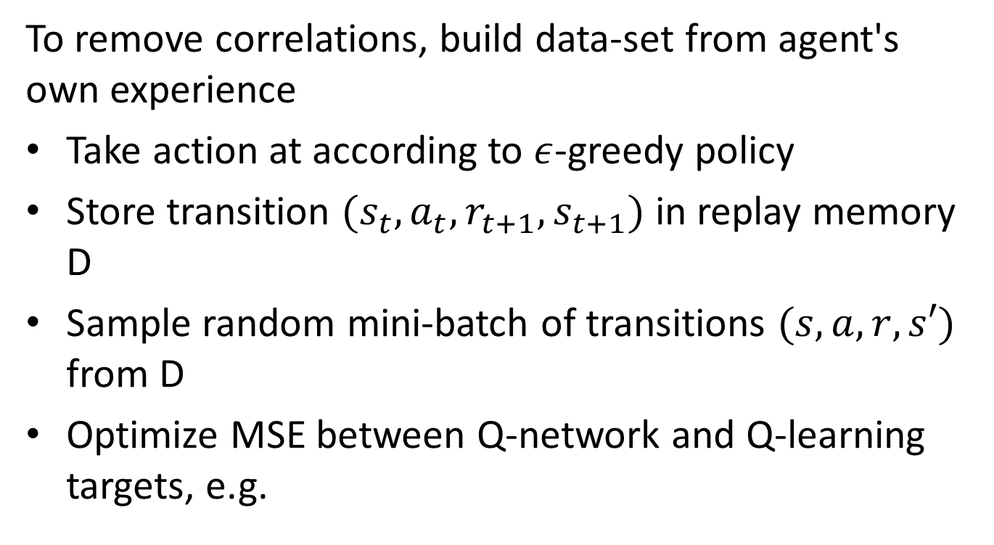
Deep Q-Networks: Experience Replay
To remove correlations, build data-set from agent's own experience
Take action at according to $ε$-greedy policy
Store transition $(s_{t}, a_{t}, r_{t+1}, s_{t+1})$ in replay memory D
Sample random mini-batch of transitions $(s, a, r, s′)$ from D
Optimize MSE between Q-network and Q-learning targets, e.g.
$$L\left(θ\right)=E_{s,a,r,s^{′}∼D}\left[{\left(r+γ\max_{a^{′}}Q\left(s^{′},a^{′};θ\right)−Q\left(s,a;θ\right)\right)}^{2}\right]$$

Slide 16
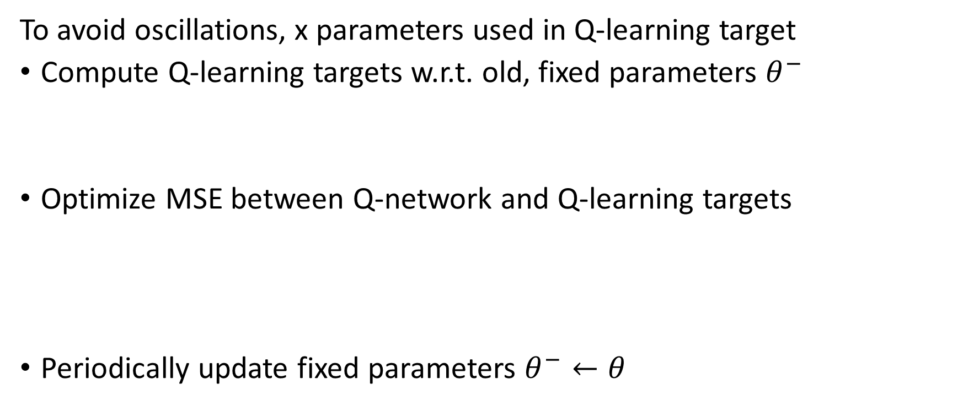

Deep Q-Networks: Fixed target network
To avoid oscillations, x parameters used in Q-learning target
Compute Q-learning targets w.r.t. old, fixed parameters $θ^{−}$
Optimize MSE between Q-network and Q-learning targets
Periodically update fixed parameters $θ^{−}←θ$
$$r+γ\max_{a^{′}}Q\left(s^{′},a^{′};θ^{−}\right)$$
$$L\left(θ\right)=E_{s,a,r,s^{′}∼D}\left[{\left(r+γ\max_{a^{′}}Q\left(s^{′},a^{′};θ^{−}\right)−Q\left(s,a;θ\right)\right)}^{2}\right]$$

Slide 17
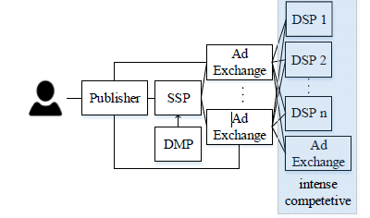
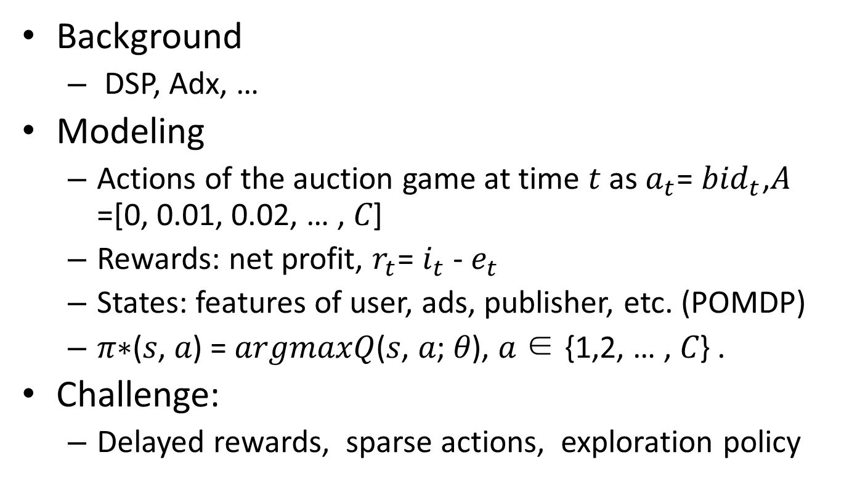
Learning Bidder for RTB Auction
Background
DSP, Adx, …
Modeling
Actions of the auction game at time 𝑡 as $a_{t}$= ${bid}_{t}$,𝐴 =[0, 0.01, 0.02, … , 𝐶]
Rewards: net profit, $r_{t}$= $i_{t}$ - $e_{t}$
States: features of user, ads, publisher, etc. (POMDP)
𝜋∗(𝑠, 𝑎) = 𝑎𝑟𝑔𝑚𝑎𝑥𝑄(𝑠, 𝑎; 𝜃), 𝑎 ∈ {1,2, … , 𝐶} .
Challenge:
Delayed rewards, sparse actions, exploration policy

Slide 18
Further Advances
AlphaGo
SL policy + RL policy network + RL value network
Monte-Carlo Tree Search
DDPG (Deep deterministic policy gradient)
DQN : discrete and low-dimensional action space
Actor-critic architecture based on DPG
Apply to continuous action space
A3C(Asynchronous advantage actor-critic)
Parallel actor-learners
De-correlates the agents’ data
Half the training time
Discrete or continuous action space

